Slide 1
K-Means con OpenMP
Parallel Programming for Machine Learning
LM Intelligenza Artificiale
A.A. 2023/2024
Piqué Gregorio
24/02/2024

Slide 2
K-Means con OpenMP
24/02/2024
Indice
Introduzione
K-Means
Metodologia
Implementazione
Risultati
Conclusioni

Slide 3

K-Means con OpenMP
24/02/2024
Introduzione
Mid-Term Project
Programmazione parallela
Algoritmo clustering K-Means
Sviluppo con API OpenMP

Slide 4
K-Means con OpenMP
24/02/2024
K-Means
Algoritmo di Unsupervised Machine Learning
Raggruppamento di punti in cluster
Quattro fasi:
Inizializzazione centroidi
Assegnamento punti
Aggiornamento centroidi
Ripetizione step 2-3 fino a convergenza

Slide 5
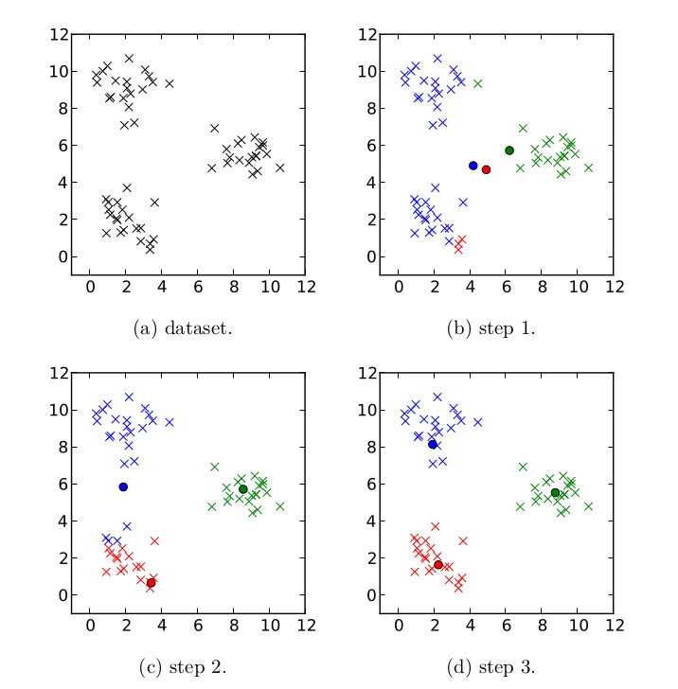
K-Means con OpenMP
24/02/2024
K-Means
Algoritmo di Unsupervised Machine Learning
Raggruppamento di punti in cluster
Quattro fasi:
Inizializzazione centroidi
Assegnamento punti
Aggiornamento centroidi
Ripetizione step 2-3 fino a convergenza

Slide 6
K-Means con OpenMP
24/02/2024
Metodologia
Centroidi inizializzabili con coordinate casuali, punti del dataset, etc…
Possibili minimi locali
Più esecuzioni, salvando soluzioni intermedie
Soluzione migliore con SSE minore

Slide 7
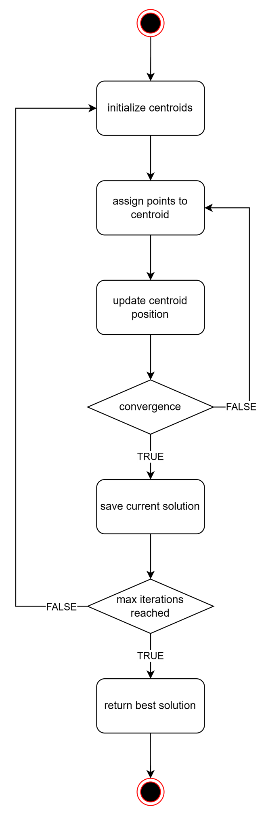
K-Means con OpenMP
24/02/2024
Metodologia
Centroidi inizializzabili con coordinate casuali, punti del dataset, etc…
Possibili minimi locali
Più esecuzioni, salvando soluzioni intermedie
Soluzione migliore con SSE minore

Slide 8
K-Means con OpenMP
24/02/2024
Implementazione
Classi:
Points
Centroids
Kmeans
Solution
Implementazione con API OpenMP

Slide 9
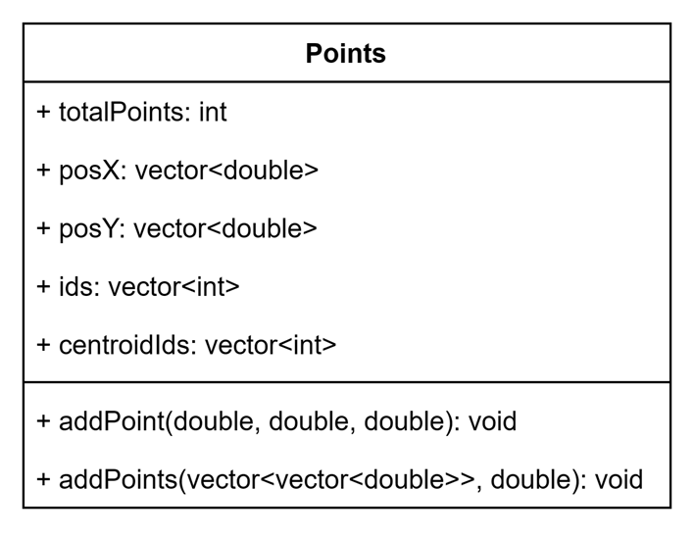
K-Means con OpenMP
24/02/2024
Points

Slide 10
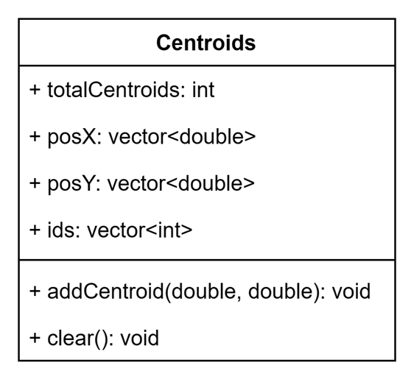
K-Means con OpenMP
24/02/2024
Centroids

Slide 11
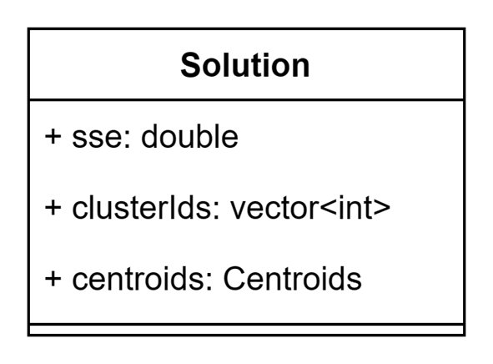
K-Means con OpenMP
24/02/2024
Solution

Slide 12
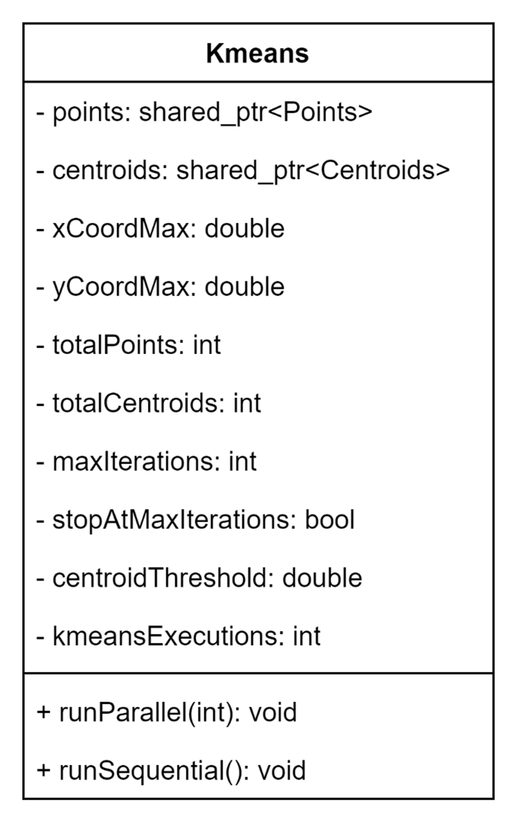
K-Means con OpenMP
24/02/2024
Kmeans

Slide 13
K-Means con OpenMP
24/02/2024
Codice Sorgente
Versione sequenziale
Versione parallela

Slide 14
K-Means con OpenMP
24/02/2024
void Kmeans::runParallel(int numThreads) {
// initialize current centroids and points
Centroids centroids{ totalCentroids };
Points points = *p;
// vector of kmeans solutions
vector<Solution> solutions(kmeansExecutions);
// variables for convergence check
bool notConverged = true;
int it = 0;
int totCentroidsMoved = 0;
double currSse = 0.0;
double centroidThresholdSquared = centroidThreshold * centroidThreshold;
// vectors to store centroid positions and counts for each thread
vector<double> centroidPositionsX(totalCentroids * numThreads);
vector<double> centroidPositionsY(totalCentroids * numThreads);
vector<int> centroidCounts(totalCentroids * numThreads);
// initialize centroids with random points
mt19937_64 gen(seed);
vector<int> indices{ points.ids };
vector<int> executionInitCentroids(kmeansExecutions * totalCentroids);
for (int run = 0; run < kmeansExecutions; ++run){
shuffle(indices.begin(), indices.end(), gen);
for (int i = 0; i < totalCentroids; i++) {
executionInitCentroids[run * totalCentroids + i] = indices[i];
}
}

Slide 15
K-Means con OpenMP
24/02/2024
// start of parallel section
#pragma omp parallel shared(centroids, points, solutions, executionInitCentroids, notConverged, it, currSse, totCentroidsMoved, centroidPositionsX, centroidPositionsY, centroidCounts) default(none) num_threads(numThreads){
int threadID = omp_get_thread_num();
double pointX, pointY;
int closestCentroidId;
double closestCentroidDist;
double deltaX, deltaY, distance;
bool assignToCentroid;
int index;
double x, y, count;
double newX, newY;
int centroidId;
// run kmeans for each set of initial centroids
for (int run = 0; run < kmeansExecutions; ++run){
// reset convergence variables for current run
#pragma omp single nowait{
totCentroidsMoved = 0;
currSse = 0;
notConverged = true;
it = 0;
}
// 1. Set initial centroids for current run
#pragma omp for
for (int i = 0; i < totalCentroids; i++){
index = executionInitCentroids[run * totalCentroids + i];
centroids.posX[i] = points.posX[index];
centroids.posY[i] = points.posY[index];
centroids.ids[i] = i;
}

Slide 16
K-Means con OpenMP
24/02/2024
// kmeans run start
while (notConverged){
// 2. Assign points to closest centroid
#pragma omp for
for (int i = 0; i < totalPoints; i++){
pointX = points.posX[i];
pointY = points.posY[i];
closestCentroidId = 0;
closestCentroidDist = -1;
// find closest centroid to point
for (int j = 0; j < totalCentroids; j++){
deltaX = centroids.posX[j] - pointX;
deltaY = centroids.posY[j] - pointY;
distance = deltaX * deltaX + deltaY * deltaY;
// update closest centroid if distance is smaller
if (distance < closestCentroidDist || closestCentroidDist < 0) {
closestCentroidDist = distance;
closestCentroidId = centroids.ids[j];
points.centroidIds[i] = closestCentroidId;
}
}
// sum the position of current point associated to its centroid, for each thread
centroidPositionsX[closestCentroidId + totalCentroids * threadID] += pointX;
centroidPositionsY[closestCentroidId + totalCentroids * threadID] += pointY;
centroidCounts[closestCentroidId + totalCentroids * threadID]++;
}

Slide 17
K-Means con OpenMP
24/02/2024
// 3. Update centroid positions, reduction on total moved centroids
#pragma omp for reduction(+:totCentroidsMoved)
for (int i = 0; i < totalCentroids; i++){
x = 0;
y = 0;
count = 0;
// sum the coordinates of points associated to a centroid, for each thread
for (int j = 0; j < numThreads; j++){
index = j * totalCentroids + i;
x += centroidPositionsX[index];
y += centroidPositionsY[index];
count += centroidCounts[index];
}
// update centroid position if there are points associated to it
if (count > 0) {
newX = x / count;
newY = y / count;
deltaX = newX - centroids.posX[i];
deltaY = newY - centroids.posY[i];
distance = deltaX * deltaX + deltaY * deltaY;
if (distance > centroidThresholdSquared) {
centroids.posX[i] = newX;
centroids.posY[i] = newY;
totCentroidsMoved++;
}
}
}

Slide 18
K-Means con OpenMP
24/02/2024
// find SSE of current solution
#pragma omp for reduction(+:currSse)
for (int i = 0; i < totalPoints; i++){
centroidId = points.centroidIds[i];
deltaX = centroids.posX[centroidId] - points.posX[i];
deltaY = centroids.posY[centroidId] - points.posY[i];
currSse += sqrt(deltaX * deltaX + deltaY * deltaY);
}
// 4. Check stop conditions: no centroids moved or max iterations reached
#pragma omp single
{
// if no centroids moved or max iterations reached, save solution
if (totCentroidsMoved == 0 || (stopAtMaxIterations && it == maxIterations)) {
solutions[run] = Solution{ currSse, centroids, points.centroidIds };
notConverged = false;
}
// update iteration counter, reset solution results and helper variables
totCentroidsMoved = 0;
currSse = 0;
it++;
// reset helper vectors
std::fill(centroidPositionsX.begin(), centroidPositionsX.end(), 0);
std::fill(centroidPositionsY.begin(), centroidPositionsY.end(), 0);
std::fill(centroidCounts.begin(), centroidCounts.end(), 0);
}
}
// kmeans run end
#pragma omp barrier
}
}
// end of parallel section

Slide 19
K-Means con OpenMP
24/02/2024
// find and return best solution
auto bestSolution = min_element(solutions.begin(), solutions.end(),
[](const Solution& sol1, const Solution& sol2) {
return sol1.sse < sol2.sse;
}
);
*c = bestSolution->centroids;
p->centroidIds = bestSolution->clusterIds;
}

Slide 20
K-Means con OpenMP
24/02/2024
Risultati
Clustering su dati generati in modo flessibile
Risultati salvati su file .csv
Soluzione come coordinate dei centroidi
Performance test

Slide 21
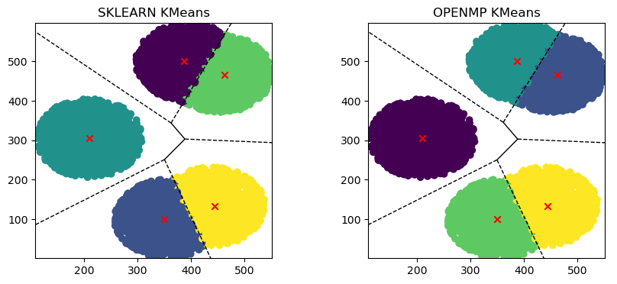
K-Means con OpenMP
24/02/2024
Risultati - Esempio sklearn vs OpenMP

Slide 22
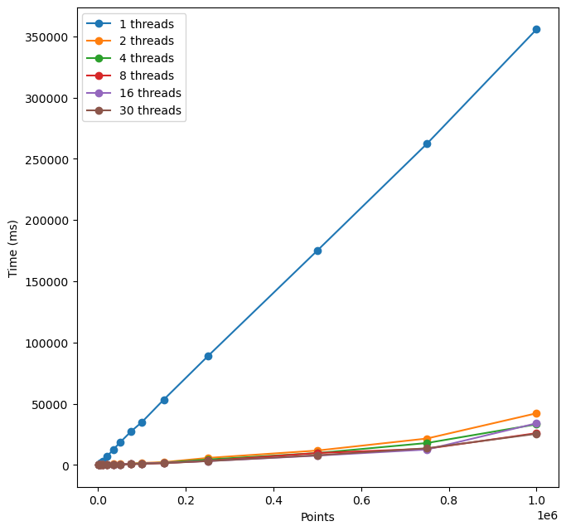
K-Means con OpenMP
24/02/2024
Performance per Numero di Punti

Slide 23
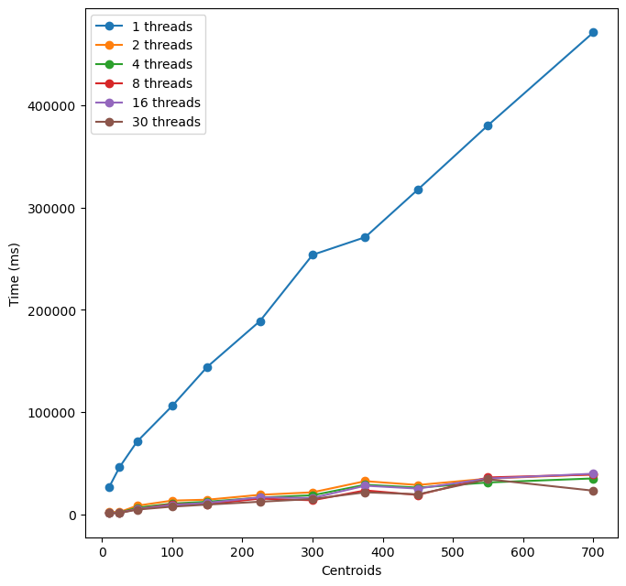
K-Means con OpenMP
24/02/2024
Performance per Numero di Centroidi

Slide 24
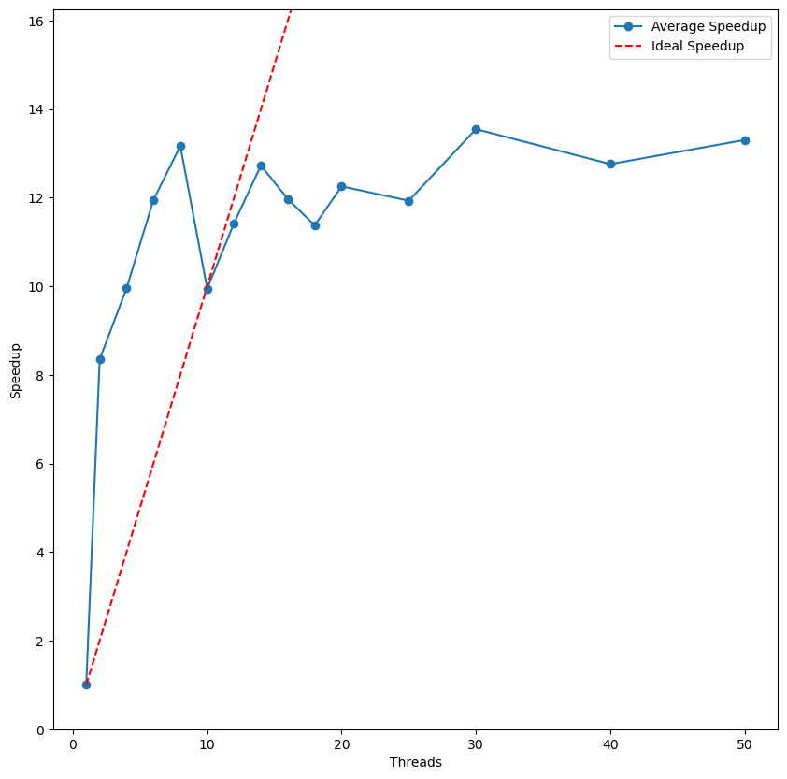
K-Means con OpenMP
24/02/2024
Speedup

Slide 25
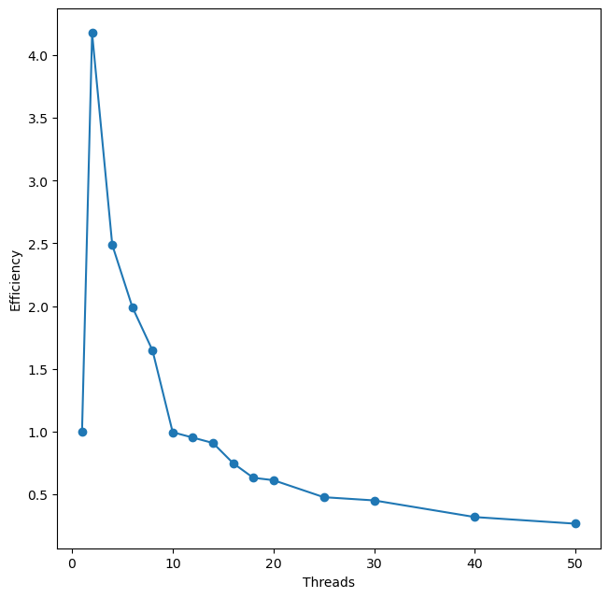
K-Means con OpenMP
24/02/2024
Efficiency

Slide 26
K-Means con OpenMP
24/02/2024
Conclusioni
K-Means con OpenMP
Parallelizzazione su core CPU
Implementazione sequenziale e parallela
Speedup sublineare, ottimale con 2-14 thread
Efficiency >1 con 2-10 thread

